Slide 1
Predicting Stock Prices with Metropolis-Hastings MCMC
Pranav Bhadharla and Jiyong Kim

Slide 2

Background
The goal of our project was to apply Metropolis-Hastings to two ETFs: SPY(S&P 500 ETF) and QQQ (Nasdaq index ETF) to predict future closing prices of these two ETFs.
We priced the equations using geometric brownian motion, specifically using:

Slide 3
Modeling SPY

Slide 4
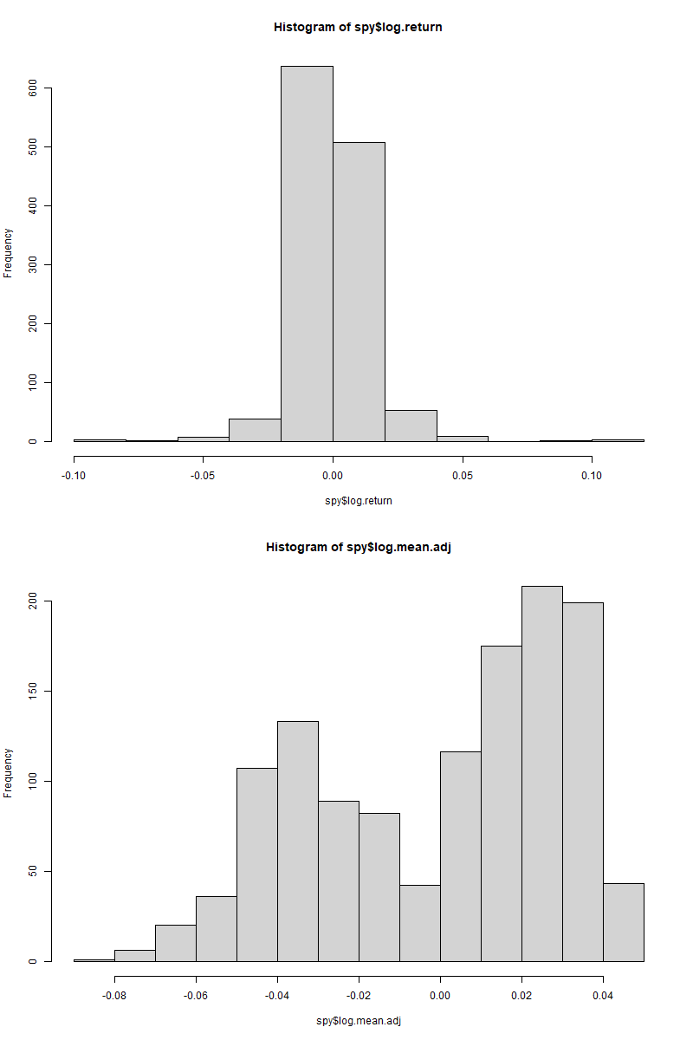
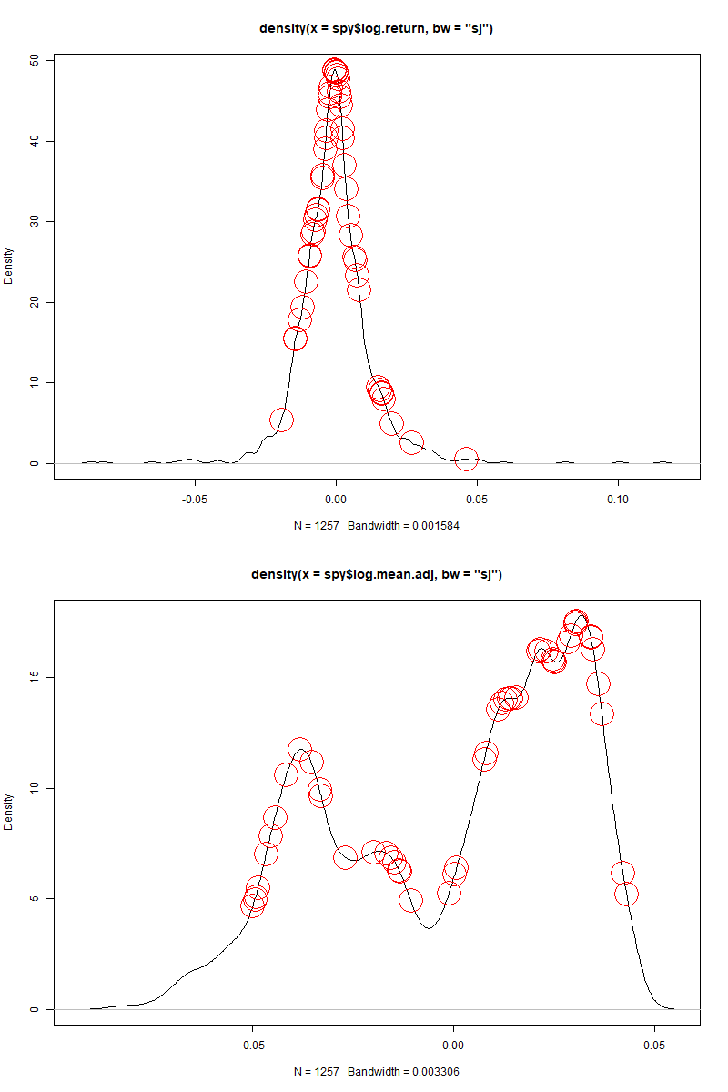
Using log SPY data provided easier distributions to draw from
By taking the log of the closing prices, we could apply a normal distribution as our proposal density function
Sheater & Jones was used to find the bandwidth of our proposal density function
To test the effects of proposal functions, two density functions were estimated from each; daily log returns and mean adjusted returns.
Item 2

Slide 5
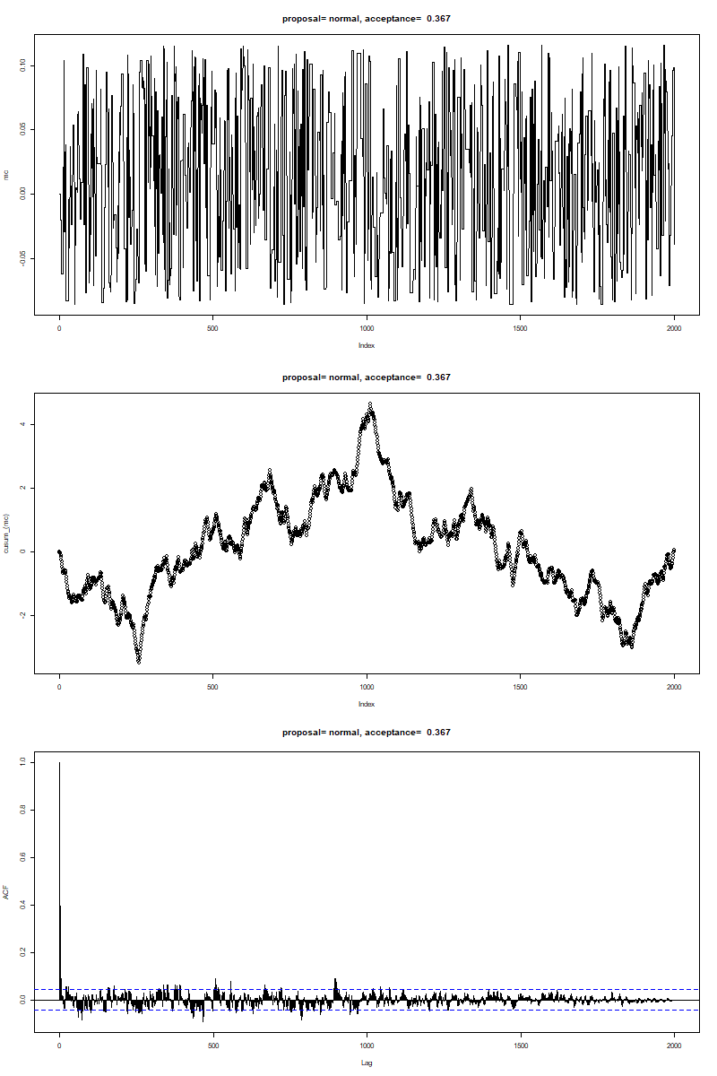
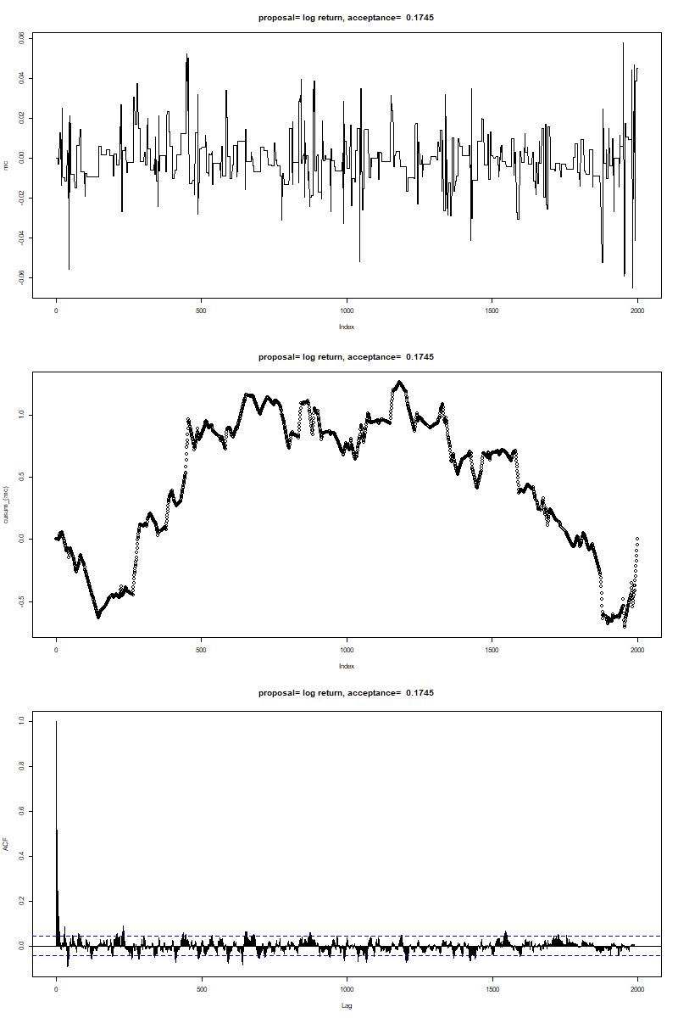
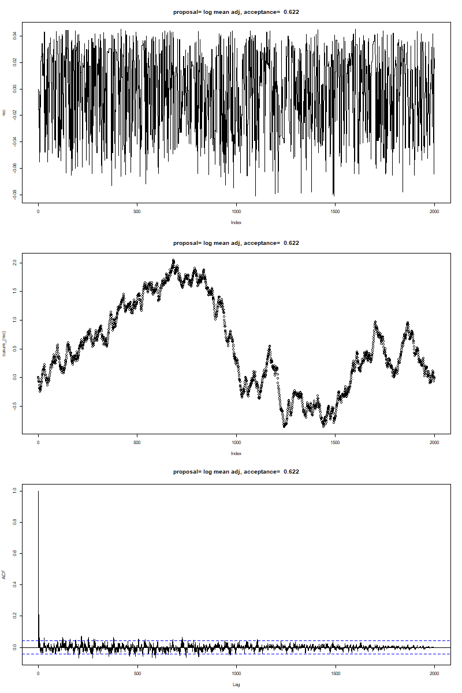
Metropolis-Hastings was used to create a markov chain of the random component of the pricing equation
Normal Distribution
Log Return
Log Mean Adjusted
Markov Chain
By verifying sample path, cusum, and autocorrelation plots, we claim each of our MH generated chains are ergodic.
Sample path shows variational movements depending on proposal density estimates.
Cusum moves but manages to converge to 0
The acf converges quickly, which aligns with our expectations
Cumulative Sum of Markov Chain

Slide 6
The Markov Chain was used to predict prices for various intervals
Time Period | No Burn-in RMSE | Burn-in RMSE
1 year | 23.7 | 23.6
6 months | 21.4 | 21.4
3 months | 17.0 | 16.9
1 month | 17.2 | 17.3
The markov chain was used to predict prices for the last year, half year, quarter, and month of the data
The process used a chain length of 2000, each period of time was tested using without and with a burn-in
In the case of burn-in, the end of the chain was used
The average RMSE was taken for each time period
Item 2

Slide 7
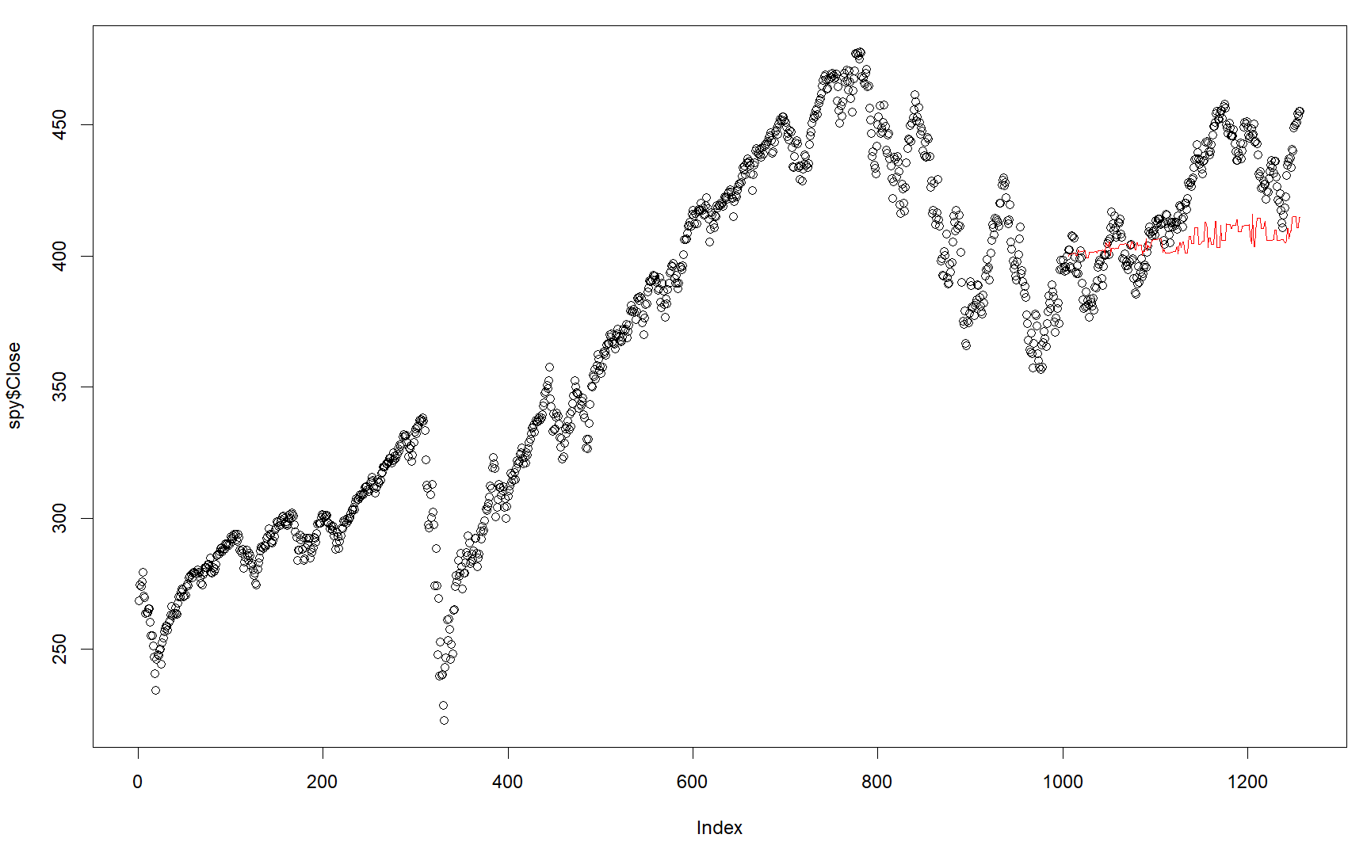
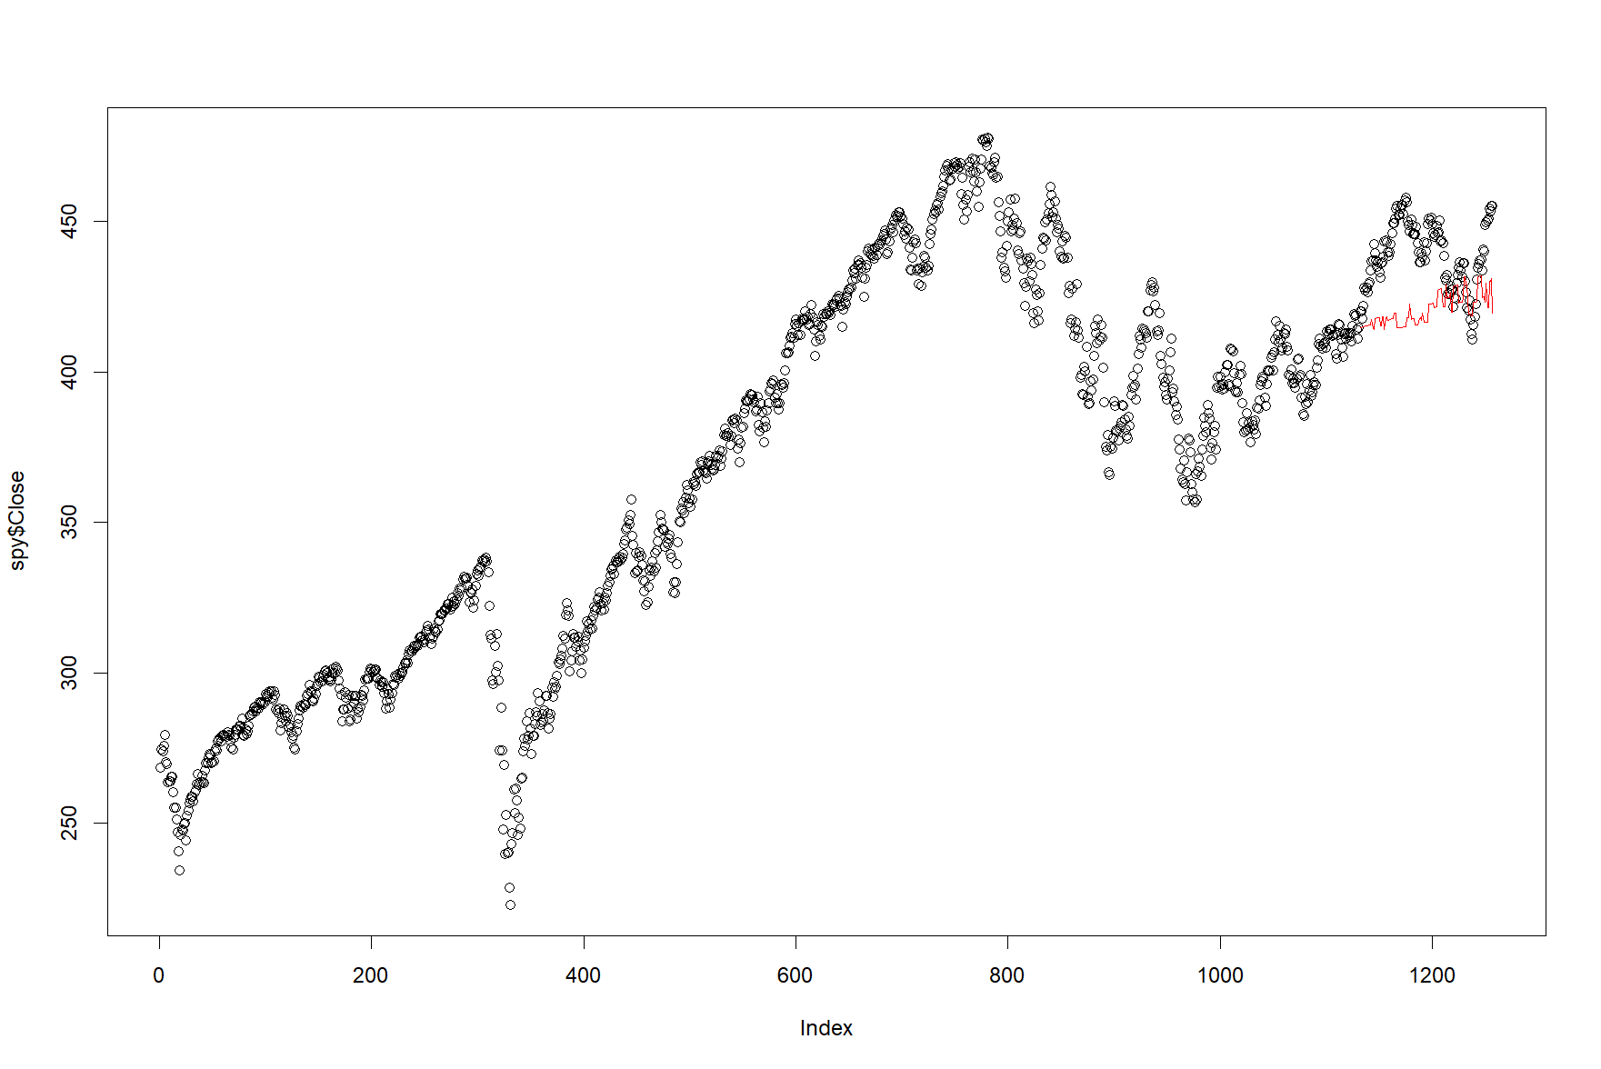
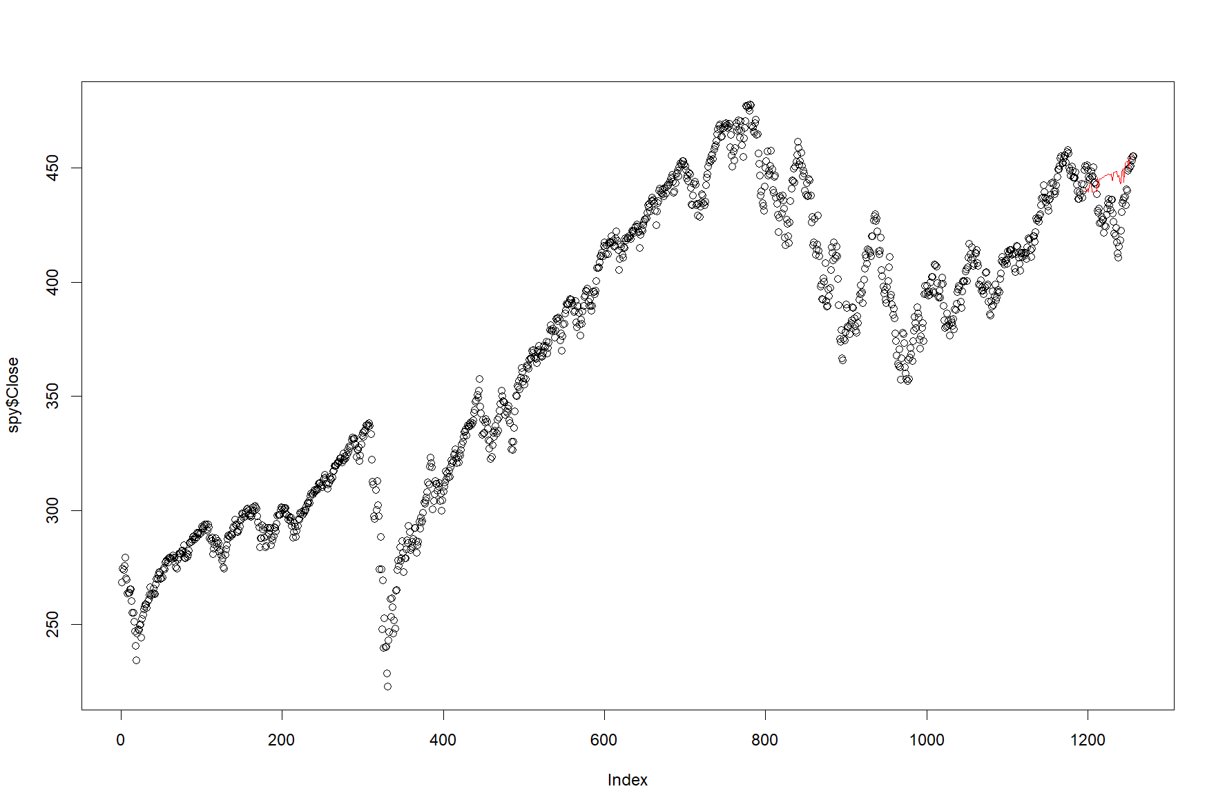
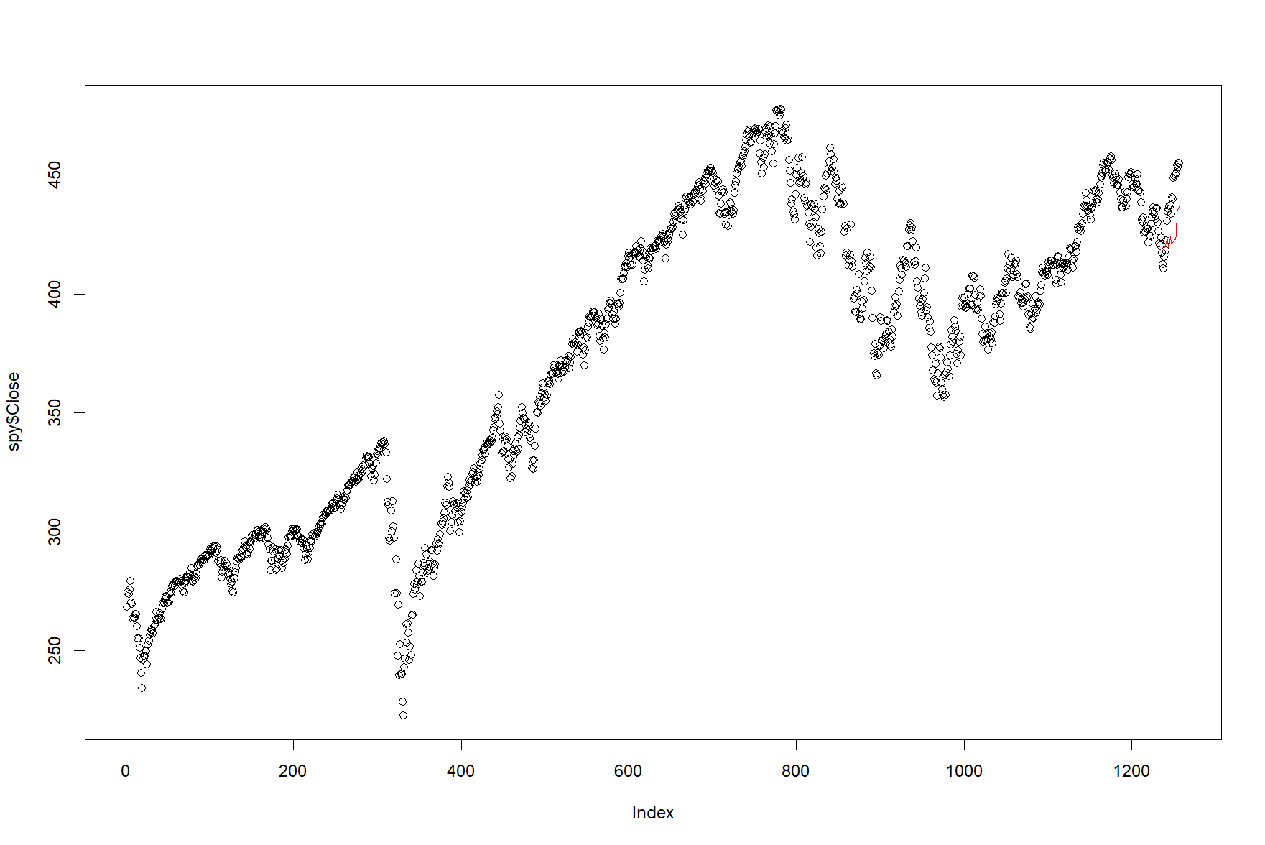
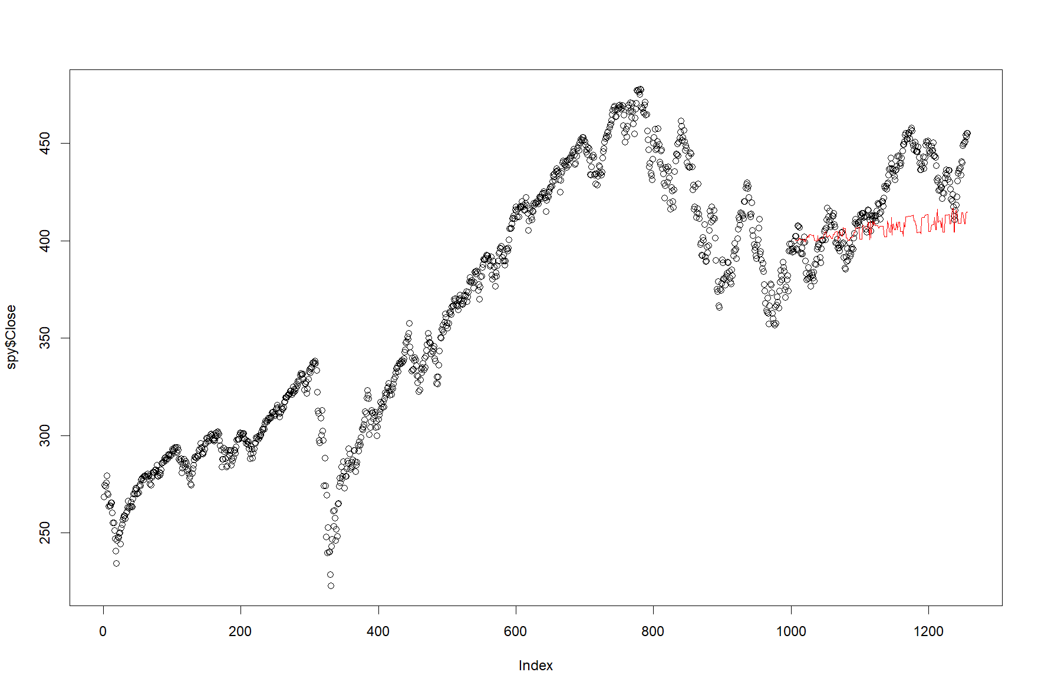



Using MH provided mixed results
1 Year
6 Months
3 Months
1 Month
No Burn-in
Item 2\
Burn-in
Predictions are directionally correct, but have easily identifiable errors

Slide 8
Modeling QQQ

Slide 9
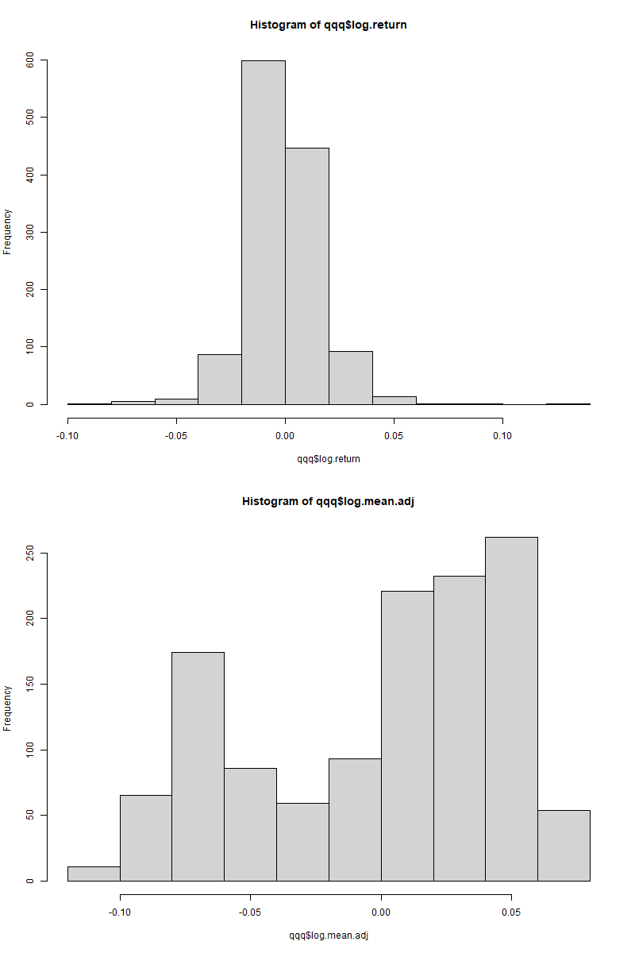
Using log QQQ data provided easier distributions to draw from
Once again, by taking the log of the closing prices, we could apply a normal distribution as our proposal density function
Sheater & Jones was again used to find the bandwidth of our proposal density function
While using a normal distribution still makes sense, the fit for QQQ appeared to visually be better
Item 2

Slide 10
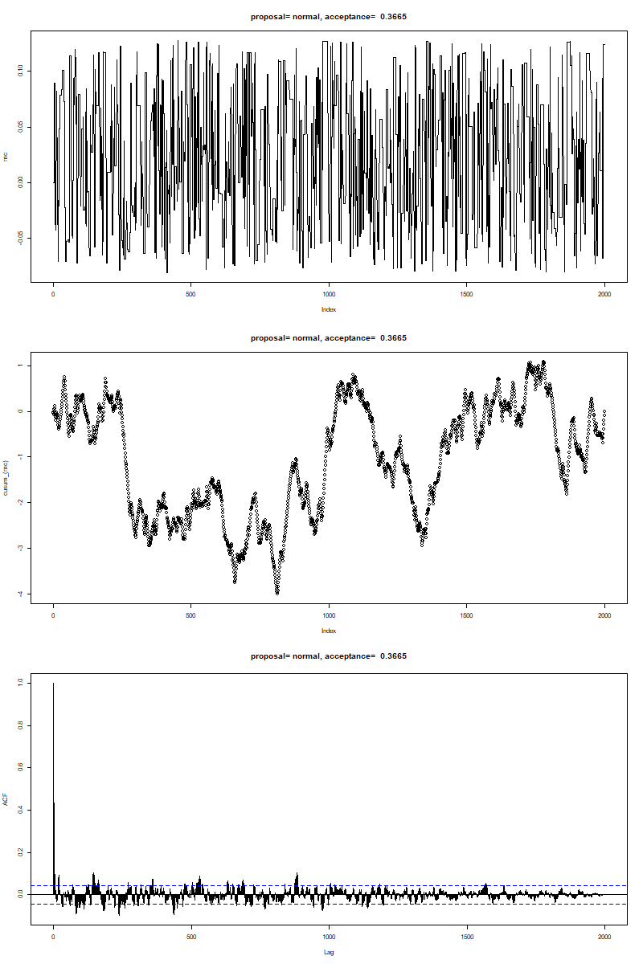
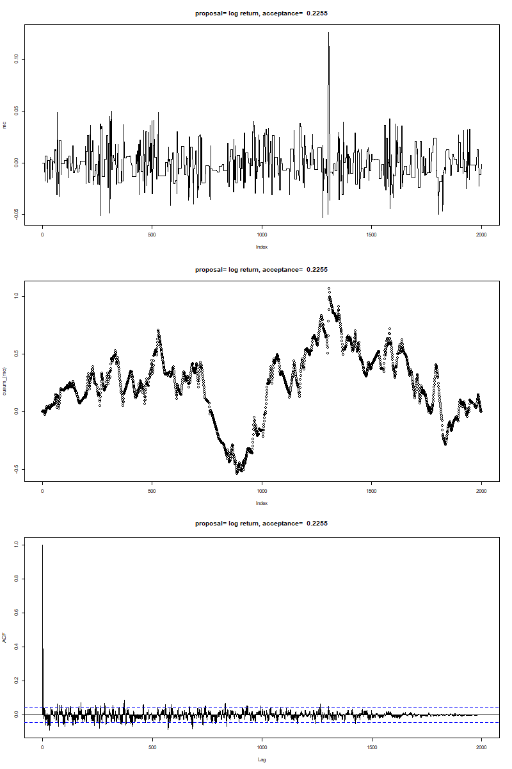
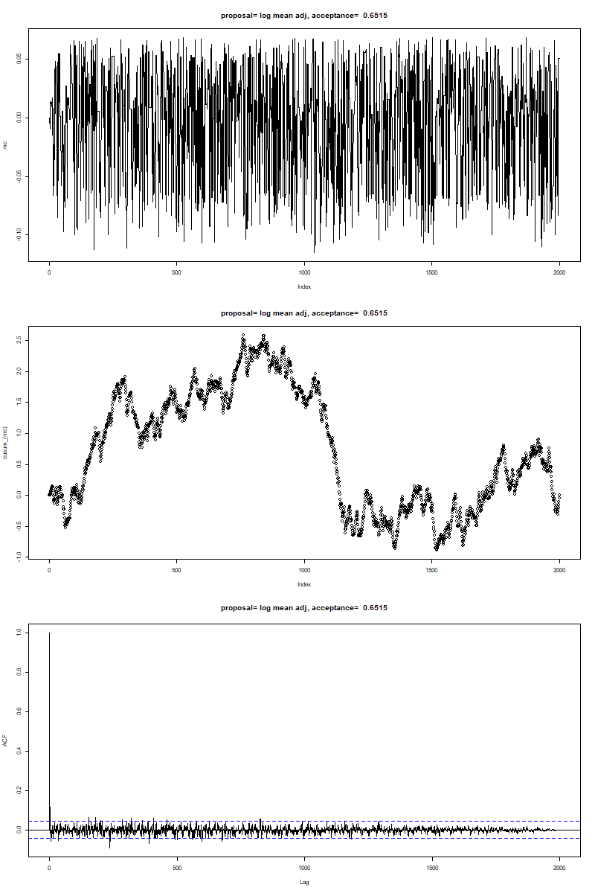
Metropolis-Hastings was used to create a markov chain of the random component of the pricing equation
Normal Distribution
Log Return
Log Mean Adjusted
Similar convergence pattern as SPY also emerges
By verifying sample path, cusum, and autocorrelation plots, we claim each of our MH generated chains are ergodic.
Sample path shows noticeable difference in movements
Cusum also manages to converge to 0
The acf converges quickly, which aligns with our expectations
Markov Chain
Cumulative Sum of Markov Chain

Slide 11
The Markov Chain was used to predict prices for various intervals
Time Period | No Burn-in RMSE | Burn-in RMSE
1 year | 59.6 | 59.5
6 months | 28.7 | 28.7
3 months | 11.6 | 11.7
1 month | 25.2 | 25.4
The markov chain was used to predict prices for the last year, half year, quarter, and month of the data
The process used a chain length of 1200, each period of time was tested using without and with a burn-in
In the case of burn-in, the end of the chain was used
The average RMSE was taken for each time period
Item 2

Slide 12
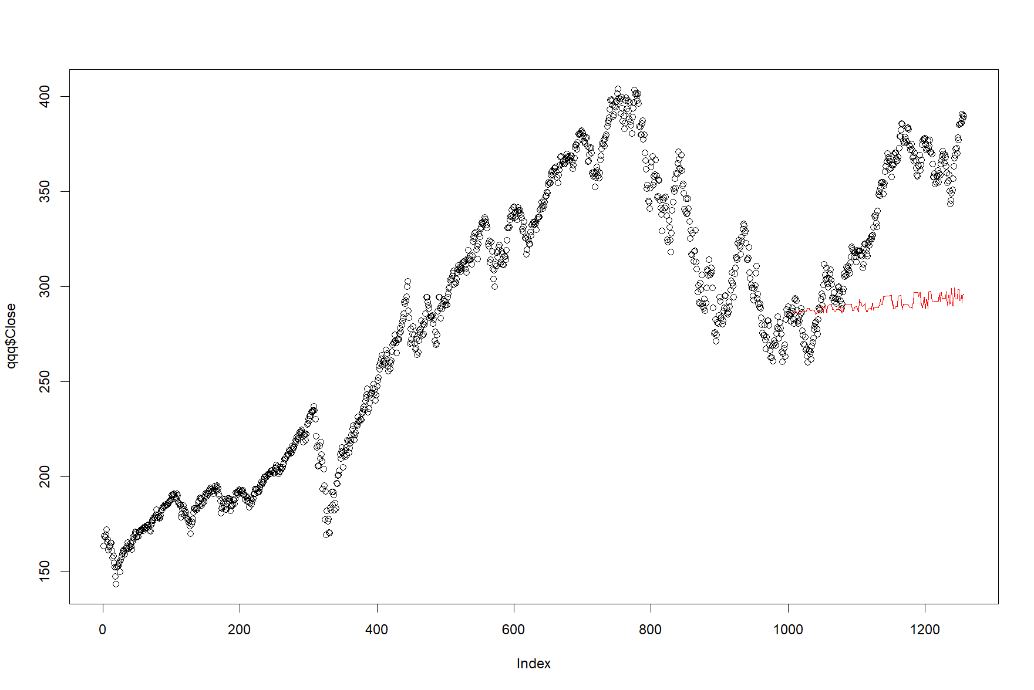
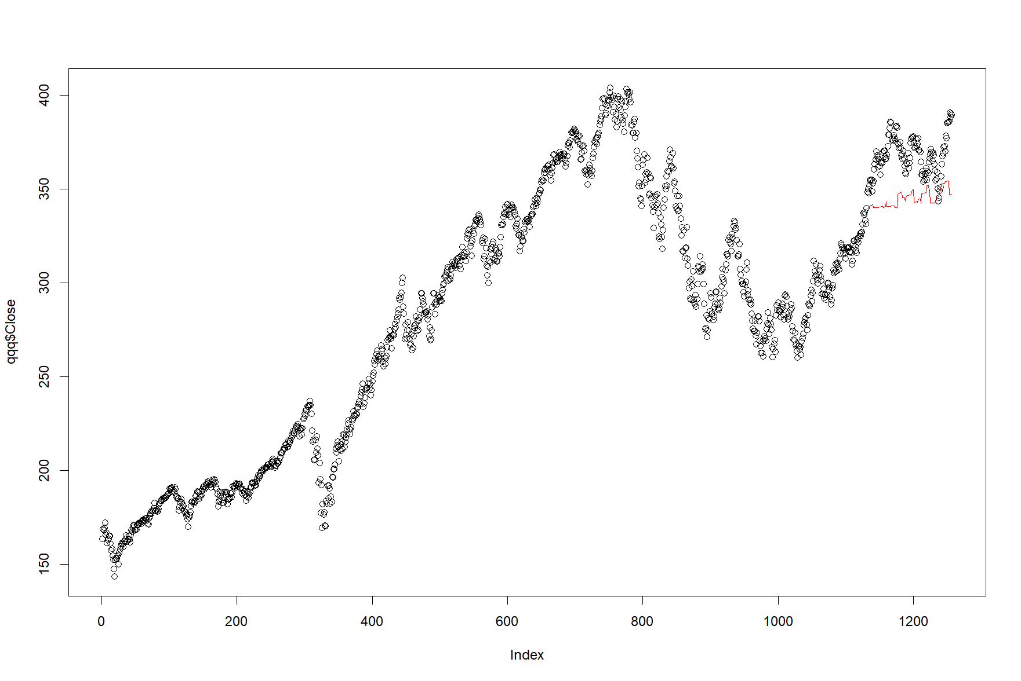
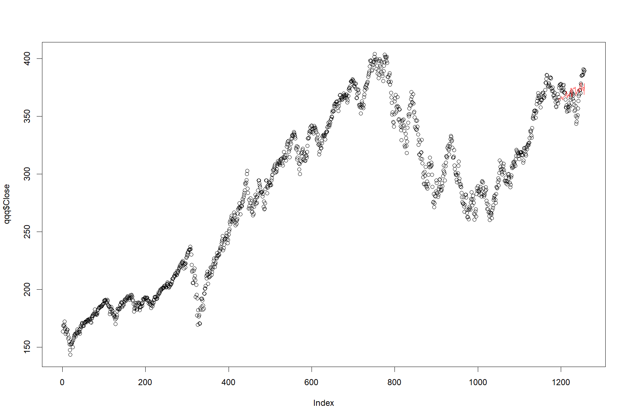
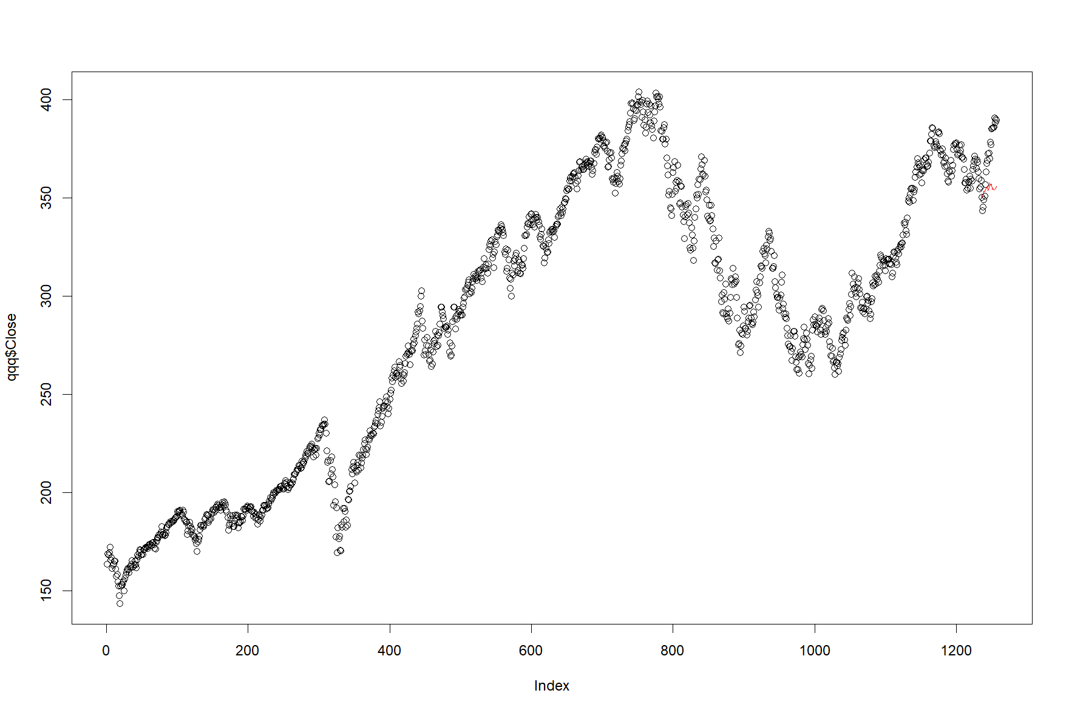




Using MH provided mixed results
1 Year
6 Months
3 Months
1 Month
No Burn-in
Item 2\
Burn-in
Overall, MH did perform well for longer periods of time

Slide 13
Conclusion

Slide 14
Markov chain generations were mostly dependent on choice of proposal
In the MCMC simulation of randomness “z”, we have tried different parameters and see their impacts.
Effect of the “burn-in”
Burn-in RMSE was lower in average by small margin (happened 45% of time).
Usefulness of the “burn-in” can be argued in our case.
Effect of the “proposal distribution”
We tried to sample from three different densities: “normal”, “ “estimated log-return”, “estimated log-mean-adjusted”
The acceptance rates were quite different 17% (log return), 37% (normal), 61% (log mean adj).
The result showed meaningful reduce in rmse (lowest with normal and log-return), and better proposal shows less oscillation in sample path
Choice of “proposal distribution” matters
Effect of the “starting value”
Since we mostly sampled from unimodal density, starting values near the modes were far more effective than starting from other distant points.
ACF reduces fast on most of the starting values
 |  | log return | mean adj | normal
QQQ | 1 month | 21.16881 | 21.20638 | 20.13555
 | 3 month | 56.33971 | 56.3382 | 55.54744
 | 6 month | 11.30635 | 11.42376 | 11.84353
 | 12 month | 25.47034 | 25.52329 | 24.71861
SPY | 1 month | 17.80406 | 17.79803 | 17.37973
 | 3 month | 24.07211 | 24.1112 | 23.57788
 | 6 month | 15.90256 | 15.95261 | 16.79812
 | 12 month | 21.83582 | 21.85775 | 21.36996

Slide 15
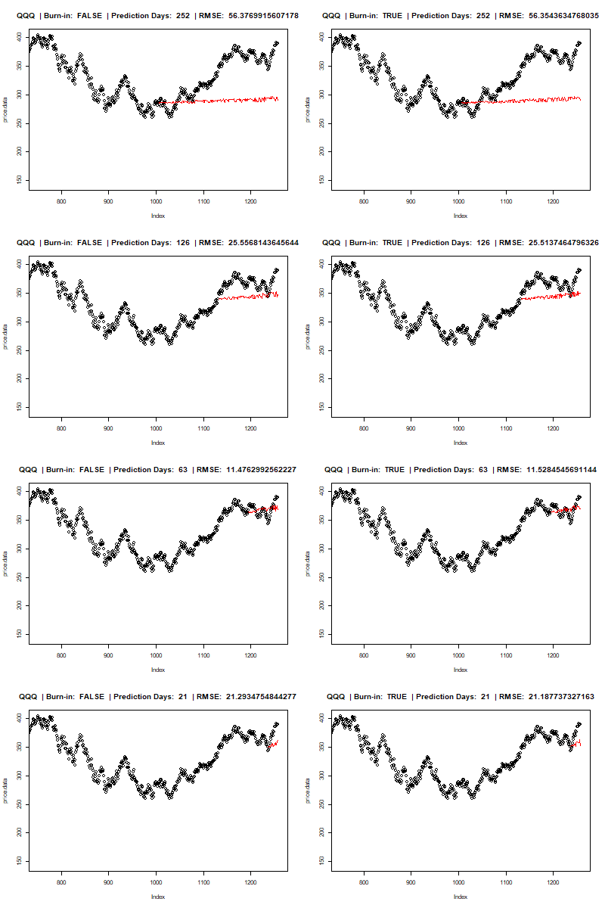
MCMC simulation return (RMSE)
Looking at the errors
The prediction error was lowest on 6 month period, and highest on 3 month interval.
The normal kernel produced the lowest estimation error, except 6 month interval.
Possible improvement suggestions
Construct more adequate proposal function with wider sampling range
Try to transform dataset into stationary time-series, and incorporate other statistical methods
Utilize bootstrap to estimate and adjust parameters if the proposal has light tails
 |  | log return | mean adj | normal
QQQ | 1 month | 21.16881 | 21.20638 | 20.13555
 | 3 month | 56.33971 | 56.3382 | 55.54744
 | 6 month | 11.30635 | 11.42376 | 11.84353
 | 12 month | 25.47034 | 25.52329 | 24.71861
SPY | 1 month | 17.80406 | 17.79803 | 17.37973
 | 3 month | 24.07211 | 24.1112 | 23.57788
 | 6 month | 15.90256 | 15.95261 | 16.79812
 | 12 month | 21.83582 | 21.85775 | 21.36996

